Slide 1

Banking Management System
SQL Analytics Project
End-to-End Banking Analytics using PostgreSQL | Comprehensive Data Analysis & Performance Optimization

Slide 2
Project Overview
Business Objectives
Data Scale & Architecture
Comprehensive banking analytics system designed to monitor customer behavior, optimize branch operations, detect fraud patterns, and enhance portfolio management across all product lines.
Enterprise-grade banking database with normalized structure ensuring data integrity and optimized query performance.
Multi-branch customer base with account relationships
Customer lifecycle tracking and segmentation
Transaction pattern analysis and anomaly detection
Real-time transaction processing across channels
Loan portfolio risk assessment
Credit card networks and merchant ecosystems
Card usage optimization and merchant insights
Loan portfolios spanning multiple product types

Slide 3

Database Architecture
Core Entities
Branches: Physical locations with operational data
Customers: Complete profile with demographics and contact information
Financial Products
Accounts: Savings, checking, salary accounts with balance tracking
Loans: Personal, home, auto loans with interest and term details
Transaction Systems
Transactions: Multi-channel deposits, withdrawals, transfers
Cards: Credit/debit cards across Visa, Mastercard, RuPay networks
Card Transactions: Purchases, cash advances, refunds
Merchant Network
Merchants: Retail partners categorized by industry and location
The architecture employs foreign key relationships ensuring referential integrity. Normalized structure enables efficient joins and maintains data consistency across all banking operations.

Slide 4

Advanced Time-Series Analysis
Month-over-Month Growth
1
Track deposit growth rates using LAG window functions to identify acceleration or deceleration trends in customer savings behavior.
2
Rolling 7-Day Withdrawals
Calculate moving averages of withdrawal activity using window frames for liquidity forecasting and cash reserve management.
Running Account Balance
3
Maintain cumulative balance tracking with SUM() OVER (PARTITION BY account_id ORDER BY txn_timestamp) for historical balance reconstruction.
4
Quarterly Transaction Trends
Aggregate transactions by quarter using DATE_TRUNC to reveal seasonal patterns and year-over-year comparisons.
Window functions enable sophisticated time-series analytics without complex self-joins, improving both query performance and code readability.
-- Running balance with window function
SELECT account_id,
txn_timestamp,
amount,
SUM(amount) OVER (
PARTITION BY account_id
ORDER BY txn_timestamp
) AS running_balance
FROM transactions
ORDER BY account_id, txn_timestamp;

Slide 5

Data Quality & Validation
Critical Quality Checks
Sample SQL Validation Query
Banking operations demand impeccable data integrity. Our validation framework identifies anomalies before they impact business decisions.
-- Detect orphan account records
SELECT a.account_id,
a.customer_id,
a.balance
FROM accounts a
LEFT JOIN customers c
ON a.customer_id = c.customer_id
WHERE c.customer_id IS NULL;
-- Check for duplicate emails
SELECT email,
COUNT(*) AS duplicate_count
FROM customers
GROUP BY email
HAVING COUNT(*) > 1;
Row Count Audit: Verifying record completeness across all tables
Orphan Records: Detecting accounts without valid customer links
Duplicate Detection: Flagging duplicate email addresses or phone numbers
Future DOB Validation: Ensuring date of birth logical consistency
Data quality checks prevent downstream analytics errors and ensure regulatory compliance. Regular validation maintains trust in reporting metrics.

Slide 6

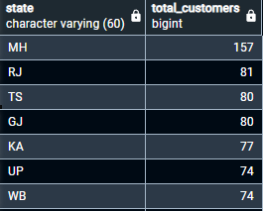
Customer & Account Analytics
01
Geographic Distribution
Analyze customer concentration by state to optimize branch placement and regional marketing strategies.
02
Onboarding Trends
Track monthly customer acquisition patterns using DATE_TRUNC functions to identify seasonal growth opportunities.
03
Account Status Health
Monitor active, dormant, and closed accounts per branch to assess operational performance.
04
High-Value Customers
Identify top 20 customers by total balance across all accounts for personalized relationship management.
Key SQL Analytics
-- 1. Customers by state (distribution)
SELECT state,COUNT(customer_id) AS Total_customers
FROM customers
GROUP BY state
ORDER BY Total_customers DESC;

Slide 7
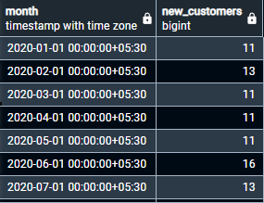
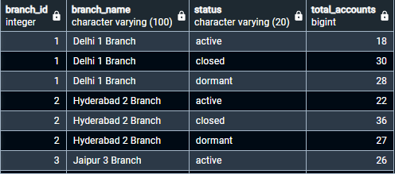
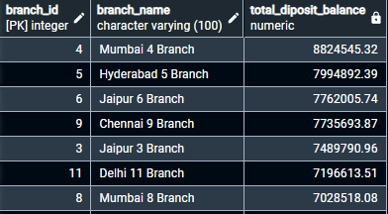
-- 2. New customers by month
SELECT DATE_TRUNC('month', created_at) AS month, COUNT(customer_id) AS new_customers
FROM customers
GROUP BY 1
ORDER BY 1;
-- 3. Accounts by status per branch
SELECT b.branch_id,b.branch_name,a.status,COUNT(account_id) AS total_accounts
FROM branches b
LEFT JOIN
accounts a
ON b.branch_id=a.branch_id
GROUP BY b.branch_id,b.branch_name,a.status
ORDER BY b.branch_id,a.status;
-- 4. Top branches by total deposit balance (sum of balances)
SELECT b.branch_id,b.branch_name,SUM(a.balance) AS total_diposit_balance
FROM branches b
LEFT JOIN
accounts a
ON b.branch_id=a.branch_id
GROUP BY b.branch_id,b.branch_name
ORDER BY total_diposit_balance DESC;

Slide 8
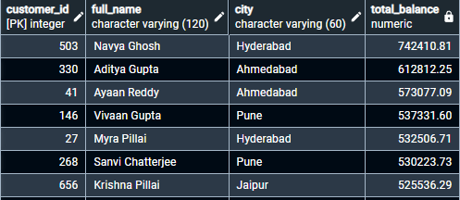
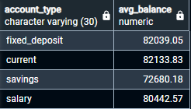
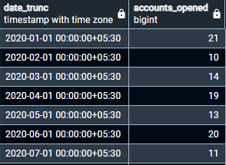
-- 5. Top 20 customers by total balance
SELECT c.customer_id,c.full_name,c.city,SUM(a.balance) AS total_balance
FROM customers c
JOIN
accounts a
ON c.customer_id=a.customer_id
GROUP BY c.customer_id,c.full_name,c.city
ORDER BY total_balance DESC
LIMIT 20;
-- 6. Average balance by account type
SELECT account_type,ROUND(AVG(balance),2) AS avg_balance
FROM accounts
GROUP BY account_type;
-- 7. Accounts opened per month (trend)
SELECT DATE_TRUNC('Month',opened_on), COUNT(*) AS accounts_opened
FROM accounts
GROUP BY 1
ORDER BY 1;

Slide 9
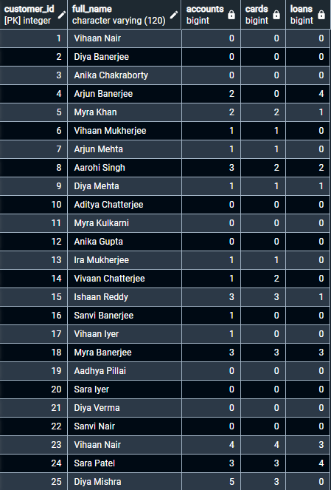
Product Penetration Analysis
3.2
68%
42%
Avg Products per Customer
Cross-Sell Opportunity
Card Adoption Rate
Accounts, cards, and loans combined
Customers with only one product type
Account holders with active cards
Multi-Product Customer Analysis
--8. Product penetration using CTEs
WITH acc AS (
SELECT c.customer_id, COUNT(a.*) AS n_accounts
FROM customers c
JOIN accounts a ON c.customer_id = a.customer_id
GROUP BY c.customer_id
),
card AS (
SELECT a.customer_id, COUNT(c.*) AS n_cards
FROM accounts a
JOIN cards c ON a.account_id = c.account_id
GROUP BY a.customer_id
),
loans AS (
SELECT a.customer_id, COUNT(l.*) AS n_loans
FROM accounts a
JOIN loans l ON a.account_id = l.account_id
GROUP BY a.customer_id
)
SELECT c.customer_id, c.full_name,
COALESCE(acc.n_accounts,0) AS accounts,
COALESCE(card.n_cards,0) AS cards,
COALESCE(loans.n_loans,0) AS loans
FROM customers c
LEFT JOIN acc ON acc.customer_id = c.customer_id
LEFT JOIN card ON card.customer_id = c.customer_id
LEFT JOIN loans ON loans.customer_id = c.customer_id
ORDER BY c.customer_id;
This CTE-based approach efficiently calculates product holdings per customer, enabling targeted cross-sell campaigns and identifying customers ready for product upgrades.

Slide 10
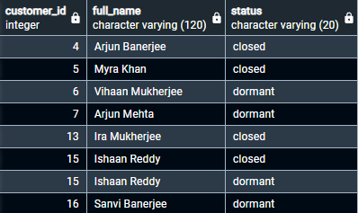
-- 9. Customers with no active accounts (anti-join)
SELECT c.customer_id,c.full_name,a.status
FROM customers c
LEFT JOIN accounts a
ON c.customer_id=a.customer_id
WHERE a.status<>'active'
GROUP BY c.customer_id,c.full_name,a.status
ORDER BY c.customer_id;

Slide 11

Transaction Analytics
Channel Performance & Cash Flow
Key Techniques
Multi-channel banking requires continuous monitoring of transaction patterns across ATM, UPI, online banking, and branch networks.
DATE_TRUNC: Monthly aggregations for trend analysis
CASE WHEN: Conditional logic for inflow vs outflow classification
Window Functions: Running balance calculations per account
INTERVAL: Time-based filtering for period analysis

Slide 12
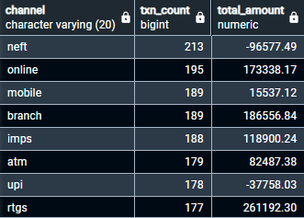
Transactions Analysis
01
Transaction Volume & Trend Analysis
Analyzed daily and monthly transaction volumes using time-based aggregations (DATE_TRUNC) to identify peak activity periods and overall transaction growth trends.
02
Inflow vs Outflow Monitoring
Classified transactions into inflows (deposits, transfers in, interest) and outflows (withdrawals, transfers out, fees) to calculate net cash movement at account and customer levels.
03
Channel Usage Analysis
Evaluated transaction distribution across channels (ATM, online, mobile, UPI, branch) to understand customer behavior and
preferred banking channels.
04
Customer & Account Activity Insights
Identified highly active customers and accounts by transaction count and total transaction value, helping highlight key customers and potential high-value segments.
Key SQL Analytics
-- 10. Channel mix in the last 90 days
SELECT channel, COUNT(*) AS txn_count, ROUND(SUM(amount),2) AS total_amount
FROM transactions
WHERE txn_timestamp >= CURRENT_DATE - INTERVAL '90 days'
GROUP BY channel
ORDER BY txn_count DESC;

Slide 13
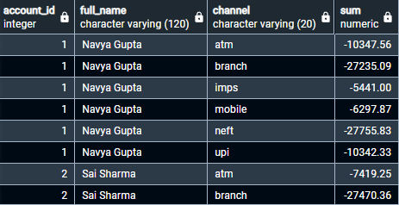
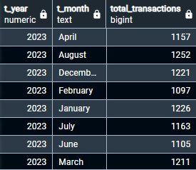
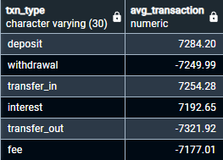
-- 11. Customers payments trend via different methods
SELECT a.account_id,c.full_name,t.channel,SUM(t.amount)
FROM accounts a
JOIN
transactions t
ON a.account_id=t.account_id
JOIN
customers c
ON a.customer_id=c.customer_id
WHERE t.description IN ('Withdrawal','Transfer Out','Interest','Fee')
GROUP BY a.account_id,c.full_name,t.channel
ORDER BY a.account_id;
-- 12. Monthly transaction counts
SELECT EXTRACT(YEAR FROM txn_timestamp ) AS t_year,TO_CHAR(txn_timestamp,'Month') AS t_month,COUNT(*) AS total_transactions
FROM transactions
GROUP BY t_year,t_month
ORDER BY EXTRACT(YEAR FROM txn_timestamp);
-- 13. Average transaction amount by type
SELECT * FROM transactions;
SELECT txn_type,ROUND(AVG(amount),2) AS avg_transaction
FROM transactions
GROUP BY txn_type;

Slide 14
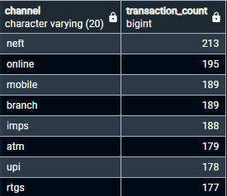
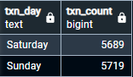
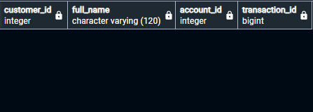
-- 14. Channel mix in last 90 days
SELECT channel, COUNT(*) AS transaction_count
FROM transactions
WHERE txn_timestamp>= CURRENT_DATE - INTERVAL '90 days'
GROUP BY channel
ORDER BY transaction_count DESC;
-- 15. Weekend transactions (Sat/Sun)
SELECT TO_CHAR(txn_timestamp, 'Day') AS txn_day,COUNT(*) AS txn_count
FROM transactions
WHERE EXTRACT (DOW FROM txn_timestamp) IN (0,6)
GROUP BY txn_day;
-- 16. Accounts with no transactions ever
SELECT c.customer_id,c.full_name,t.account_id,t.transaction_id
FROM customers c
JOIN accounts a ON c.customer_id=a.customer_id
JOIN transactions t ON a.account_id=t.account_id
WHERE t.transaction_id IS NULL
ORDER BY c.customer_id;

Slide 15
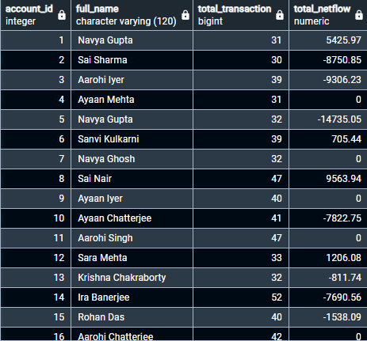
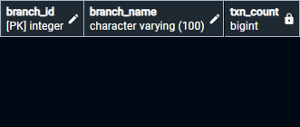
---- 17. Net inflow per account in last 90 days
WITH acc AS (
SELECT t.account_id, COUNT(*) AS n_txn
FROM transactions t
GROUP BY t.account_id
),
txn AS (
SELECT t.account_id, SUM(t.amount) AS net_inflow_90d
FROM transactions t
WHERE t.txn_timestamp >= CURRENT_DATE - INTERVAL '90 days'
GROUP BY t.account_id
)
SELECT a.account_id,
c.full_name,
COALESCE(acc.n_txn, 0) AS total_transaction,
COALESCE(txn.net_inflow_90d, 0) AS total_netflow
FROM accounts a
JOIN customers c ON c.customer_id = a.customer_id
LEFT JOIN acc ON acc.account_id = a.account_id
LEFT JOIN txn ON txn.account_id = a.account_id
ORDER BY a.account_id,
c.customer_id;
-- 18. Transactions per branch last month
SELECT b.branch_id,b.branch_name,COUNT(*) AS txn_count
FROM branches b
JOIN accounts a ON b.branch_id=a.branch_id
JOIN transactions t ON a.account_id=t.account_id
WHERE txn_timestamp>= DATE_TRUNC('Month',CURRENT_DATE) - INTERVAL '1 month'
AND txn_timestamp < DATE_TRUNC('Month',CURRENT_DATE)
GROUP BY b.branch_id,b.branch_name
ORDER BY b.branch_id;

Slide 16
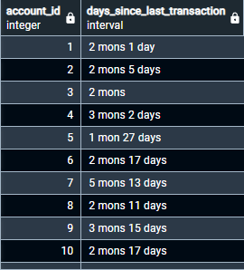
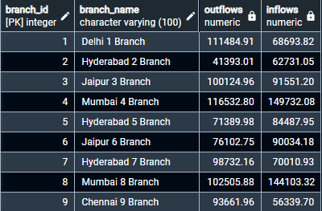
-- 19. Days since last transaction per account (snapshot)
SELECT account_id,AGE(CURRENT_DATE,MAX(txn_timestamp)::DATE) AS days_since_last_transaction
FROM transactions
GROUP BY 1
ORDER BY 1;
-- 20. Outflow vs inflow by channel by branch (last 60 days)
SELECT b.branch_id,b.branch_name,
ROUND(SUM(CASE WHEN t.txn_type IN ('withdrawal','transfer_out','fee') THEN -t.amount ELSE 0 END),2) AS outflows,
ROUND(SUM(CASE WHEN t.txn_type IN ('deposit','transfer_in','interest') THEN t.amount ELSE 0 END),2) AS inflows
FROM branches b
JOIN accounts a ON b.branch_id=a.branch_id
JOIN transactions t ON a.account_id=t.account_id
WHERE t.txn_timestamp >= CURRENT_DATE - INTERVAL '60 days'
GROUP BY b.branch_id,b.branch_name
ORDER BY b.branch_id;

Slide 17

Loan Portfolio Analytics
Portfolio Composition
Risk Assessment Metrics
Loan Types: Personal, home, auto loans with interest rate analysis
Default Rate: Percentage of defaulted loans by type
Status Distribution: Active, closed, defaulted loan tracking
High-Interest Loans: Loans above threshold requiring monitoring
Quarterly Origination: Loan start date trends by quarter
Aging Analysis: Months on book for portfolio maturity assessment
Principal Exposure: Top customers by total loan principal

Slide 18
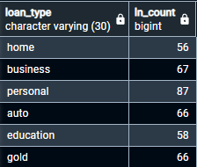
Loan Analysis
01
Loan Portfolio Composition
Analyzed the distribution of loans by type (home, personal, auto, education, business) to understand product mix and exposure across different loan categories.
02
Interest Rate & Principal Analysis
Evaluated average interest rates and total principal amounts by loan type to assess pricing trends and identify high-value loan segments.
03
Loan Status & Risk Monitoring
Assessed loan statuses (active, closed, defaulted) and calculated default rates to support basic credit risk
analysis and portfolio health monitoring.
04
Loan Aging & Tenure Analysis
Performed loan aging analysis using date calculations and intervals to classify active loans into tenure buckets, helping identify long-running and near-maturity loans.
Key SQL Analytics
-- 21. Loan count by type
SELECT loan_type,COUNT(*) AS ln_count
FROM loans
GROUP BY 1;

Slide 19
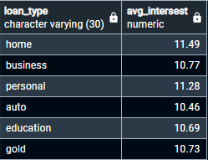
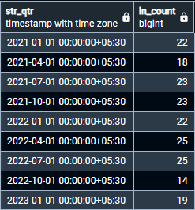
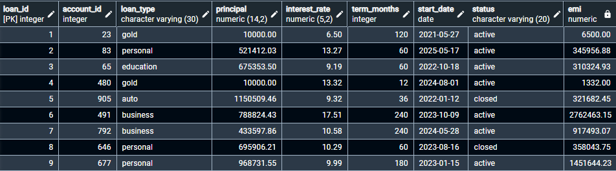
-- 22. Average interest rate by loan type
SELECT loan_type,ROUND(AVG(interest_rate),2) AS avg_intersest
FROM loans
GROUP BY 1;
-- 23. Loans started per quarter
SELECT DATE_TRUNC('quarter',start_date) AS str_qtr,COUNT(*) AS ln_count
FROM loans
GROUP BY 1
ORDER BY 1;
-- 24. EMIs per loan(simple interest)
SELECT * , ROUND((principal * interest_rate * (term_months/12)/100),2) AS EMI
FROM loans
ORDER BY loan_id;

Slide 20
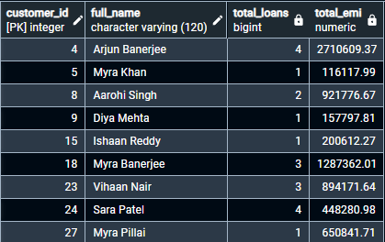
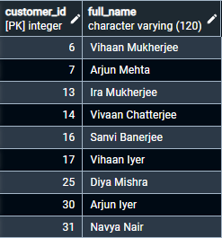
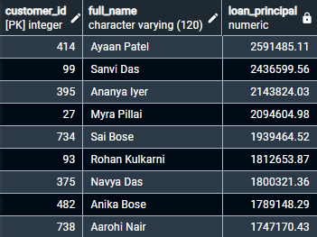
-- 25. Total EMI & loans runs per customer
SELECT c.customer_id,c.full_name,COUNT(l.*) AS total_loans,SUM(ROUND((l.principal * l.interest_rate * (l.term_months/12)/100),2)) AS total_EMI
FROM accounts a
JOIN customers c ON a.customer_id=c.customer_id
JOIN loans l ON a.account_id=l.account_id
GROUP BY c.customer_id,c.full_name
ORDER BY c.customer_id;
-- 26. Customers that hasn't run any loan
SELECT c.customer_id,c.full_name
FROM customers c
JOIN accounts a ON c.customer_id=a.customer_id
LEFT JOIN loans l ON a.account_id=l.account_id
GROUP BY c.customer_id,c.full_name
HAVING COUNT(l.*)=0
ORDER BY c.customer_id;
-- 27. Top customers by total principal (across their loans)
SELECT c.customer_id,c.full_name,
SUM(l.principal) AS loan_principal
FROM customers c
JOIN accounts a ON c.customer_id=a.customer_id
JOIN loans l ON a.account_id=l.loan_id
GROUP BY c.customer_id,c.full_name
ORDER BY loan_principal DESC
LIMIT 50;

Slide 21
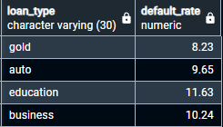
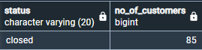
-- 28. Default rate by loan type
SELECT loan_type, ROUND(AVG(interest_rate),2) AS default_rate
FROM loans
WHERE status IN('defaulted')
GROUP BY loan_type;
-- 29. loan complition status
SELECT status, COUNT(*) AS no_of_customers
FROM loans
GROUP BY status
HAVING status='closed';

Slide 22
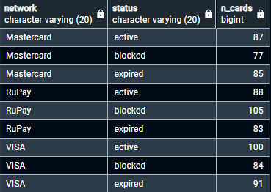
Card & Merchant Insights
01
Card Usage & Network Performance
Analyzed card distribution and transaction usage across networks (VISA, Mastercard, RuPay) to identify which card networks drive the highest customer engagement and spending activity.
02
Merchant Category Spend Patterns
Evaluated transaction volumes and spend distribution by merchant category (e.g., groceries, fuel, travel, electronics) to understand customer spending behavior and priority sectors.
03
Refund & Cash Advance Monitoring
Assessed refund frequency and cash-advance utilization to identify potential dissatisfaction indicators and
risk-prone spending behaviors in specific categories or customer segments.
04
Customer-Level Spend Profiling
Aggregated card transactions by customer to rank high-value cardholders, calculate lifetime spend, and uncover revenue opportunities through targeted card or merchant campaigns.
Key SQL Analytics
-- 30. Cards by network and status
SELECT network,status,COUNT(*) AS n_cards
FROM cards
GROUP BY network,status
ORDER BY network,status;

Slide 23
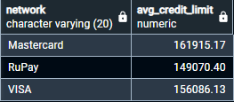
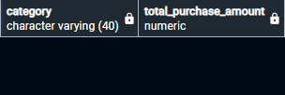
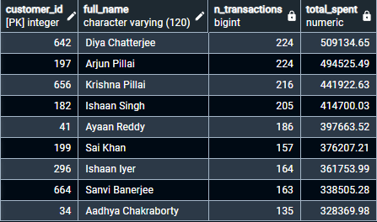
-- 31. Average credit limit by network
SELECT network,ROUND(AVG(credit_limit),2) AS avg_credit_limit
FROM cards
GROUP BY 1
ORDER BY 1;
-- 32. Purchases last month by merchant category
SELECT m.category,SUM(c.amount) AS total_purchase_amount
FROM merchants m
JOIN card_transactions c ON m.merchant_id=c.merchant_id
WHERE c.txn_timestamp>=DATE_TRUNC('Month',CURRENT_DATE) - INTERVAL '1 month'
AND c.txn_timestamp<DATE_TRUNC('Month',CURRENT_DATE)
AND c.txn_type='purchase'
GROUP BY m.category
ORDER BY total_purchase_amount DESC;
-- 33.TOP 50 customer by card uses when purchasing(All time)
SELECT c.customer_id,c.full_name,
COUNT(CASE WHEN ct.txn_type='purchase' THEN ct.card_txn_id ELSE 0 END) AS n_transactions,
SUM(CASE WHEN ct.txn_type='purchase' THEN ct.amount ELSE 0 END) AS total_spent
FROM customers c
JOIN accounts a ON c.customer_id = a.customer_id
JOIN cards ca ON a.account_id = ca.account_id
JOIN card_transactions ct ON ca.card_id = ct.card_id
GROUP BY c.customer_id,c.full_name
ORDER BY total_spent DESC
LIMIT 50;

Slide 24
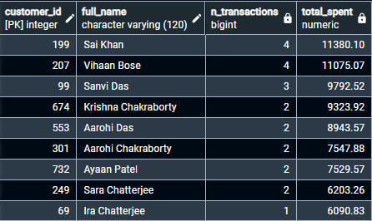
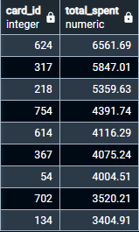
-- 34.TOP 100 customer by card uses(in this year)
SELECT c.customer_id,c.full_name,
COUNT(CASE WHEN ct.txn_type='purchase' THEN ct.card_txn_id ELSE 0 END) AS n_transactions,
SUM(CASE WHEN ct.txn_type='purchase' THEN ct.amount ELSE 0 END) AS total_spent
FROM customers c
JOIN accounts a ON c.customer_id = a.customer_id
JOIN cards ca ON a.account_id = ca.account_id
JOIN card_transactions ct ON ca.card_id = ct.card_id
WHERE ct.txn_timestamp>= CURRENT_DATE - INTERVAL '1 year'
AND ct.txn_timestamp<'2025-01-01'
GROUP BY c.customer_id,c.full_name
ORDER BY total_spent DESC
LIMIT 100;
-- 35. Cash advance total per card (last 90 days)
SELECT card_id,
SUM(CASE WHEN txn_type='cash_advance' THEN amount ELSE 0 END) AS total_spent
FROM card_transactions
WHERE txn_timestamp>= CURRENT_DATE - INTERVAL '90 days'
GROUP BY card_id
ORDER BY total_spent DESC;

Slide 25
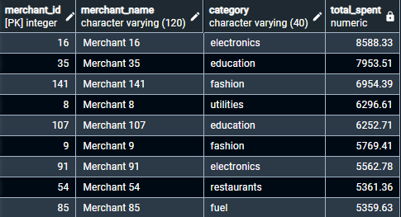
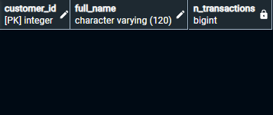
-- 36. Top 30 merchants by spend in last 60 days
SELECT m.merchant_id,m.merchant_name,m.category,
SUM(ct.amount) AS total_spent
FROM merchants m
JOIN card_transactions ct ON m.merchant_id = ct.merchant_id
WHERE ct.txn_timestamp>= CURRENT_DATE - INTERVAL '60 days'
GROUP BY m.merchant_id,m.merchant_name,m.category
ORDER BY total_spent DESC
LIMIT 30;
-- 37. Customers with cards but no card transactions
SELECT c.customer_id,c.full_name,COUNT(ct.*) AS n_transactions
FROM customers c
JOIN accounts a ON c.customer_id = a.customer_id
JOIN cards ca ON a.account_id = ca.account_id
LEFT JOIN card_transactions ct ON ca.card_id = ct.card_id
GROUP BY c.customer_id,c.full_name
HAVING COUNT(ct.*) IS NULL
ORDER BY c.customer_id,c.full_name;

Slide 26
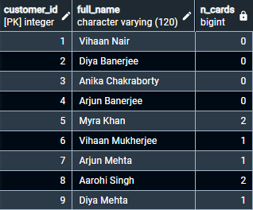
Customer 360 View
01
Unified Customer Profile Mapping
Consolidated customer demographics, account holdings, card ownership, and loan exposure into a single analytical view to enable holistic insight into individual customer relationships.
02
Product Penetration & Engagement Scoring
Calculated product mix metrics (accounts + cards + loans) per customer to measure engagement depth, identify single-product vs. multi-product customers, and prioritize upselling opportunities.
03
Behavioral & Financial Activity Indicators
Integrated transaction frequency, average balance trends, and card spend patterns to evaluate customer
activity levels and categorize customers into behavioral personas (active, at-risk, dormant).
04
Value Segmentation & Priority Targeting
Ranked customers using aggregated KPIs (total balance, total spend, loan principal exposure) to identify high-value segments and support targeted retention or growth strategies.
Key SQL Analytics
-- 38. Cardholders per customer
SELECT c.customer_id,c.full_name,COUNT(ca.*) AS n_cards
FROM customers c
LEFT JOIN accounts a ON c.customer_id = a.customer_id
LEFT JOIN cards ca ON a.account_id = ca.account_id
GROUP BY c.customer_id,c.full_name
ORDER BY c.customer_id,c.full_name;

Slide 27
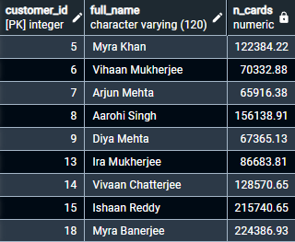
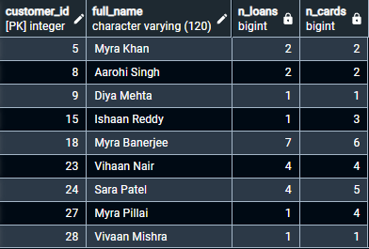
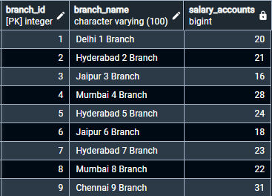
-- 39. Total card spend per customer (lifetime)
SELECT c.customer_id,c.full_name,SUM(ct.amount) AS n_cards
FROM customers c
LEFT JOIN accounts a ON c.customer_id = a.customer_id
LEFT JOIN cards ca ON a.account_id = ca.account_id
LEFT JOIN card_transactions ct ON ca.card_id = ct.card_id
GROUP BY c.customer_id,c.full_name
HAVING SUM(ct.amount) IS NOT NULL
ORDER BY c.customer_id,c.full_name;
-- 40. Customers with any loan and at least one card
SELECT c.customer_id,c.full_name,
COUNT(l.*) AS n_loans,
COUNT(ca.*) AS n_cards
FROM customers c
LEFT JOIN accounts a ON c.customer_id = a.customer_id
LEFT JOIN loans l ON a.account_id = l.account_id
LEFT JOIN cards ca ON a.account_id = ca.account_id
GROUP BY c.customer_id,c.full_name
HAVING COUNT(ca.*) >= 1 AND COUNT(l.*) >=1
ORDER BY c.customer_id,c.full_name;
-- 41. Salary accounts by branch
SELECT b.branch_id,b.branch_name,
(COUNT(a.*) FILTER(WHERE a.account_type = 'salary')) AS salary_accounts
FROM branches b
LEFT JOIN accounts a
ON b.branch_id = a.branch_id
GROUP BY b.branch_id,b.branch_name
ORDER BY b.branch_id,b.branch_name;

Slide 28
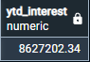
Period & KPI Snapshots
01
Time-Based Performance Tracking
Implemented monthly and quarterly financial snapshots using date truncation and interval logic to compare performance periods and monitor operational trends across the bank ecosystem.
02
Revenue & Cost Indicator Extraction
Calculated key revenue-linked KPIs such as interest credited and fee collections, alongside expense indicators like transactional outflows, to generate simplified profitability signals.
03
Customer & Account Activity Recency
Evaluated recent onboarding counts, active accounts, and recency of last transaction metrics to track
customer lifecycle movement and detect early signs of inactivity or churn risk.
04
Portfolio Health Monitoring
Built snapshot views to assess real-time portfolio exposure, including active loan volumes, card usage trends, and high-value transaction flows, enabling fast management reporting.
Key SQL Analytics
-- 42. Interest credited YTD
SELECT (SUM(amount) FILTER(WHERE txn_type = 'interest')) AS YTD_interest
FROM transactions
WHERE txn_timestamp>=DATE_TRUNC('Year',CURRENT_DATE);

Slide 29
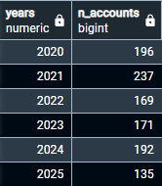
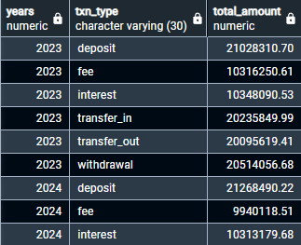
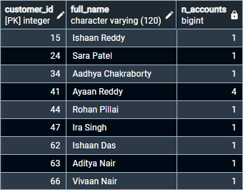
-- 43. Accounts opened by year
SELECT EXTRACT(YEAR FROM opened_on) AS years,COUNT(*) n_accounts
FROM accounts
GROUP BY 1
ORDER BY 1;
-- 44. Total transactions amounts by year
SELECT EXTRACT(YEAR FROM txn_timestamp) AS years,
txn_type,
SUM(CASE WHEN txn_type IN ('fee','transfer_out','withdrawal') THEN -amount
ELSE amount END
)AS total_amount
FROM transactions
GROUP BY years,txn_type
ORDER BY years,txn_type;
-- 45. Customers opened accounts in this year
SELECT c.customer_id,c.full_name,
COUNT(a.*) n_accounts
FROM customers c
JOIN accounts a ON c.customer_id = a.customer_id
WHERE opened_on >= DATE_TRUNC('Year',CURRENT_DATE)
GROUP BY c.customer_id,c.full_name
ORDER BY c.customer_id,c.full_name;

Slide 30
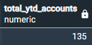
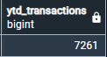
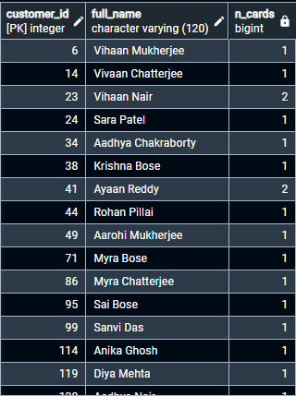
-- 46. Total accounts opened YTD
SELECT SUM(n_accounts) AS total_YTD_accounts
FROM(
SELECT COUNT(a.account_id) AS n_accounts
FROM customers c
JOIN accounts a ON c.customer_id = a.customer_id
WHERE opened_on >= DATE_TRUNC('Year',CURRENT_DATE)
);
-- 47. Transactions completed by cards in this year
SELECT COUNT(*) AS YTD_transactions
FROM card_transactions
WHERE txn_timestamp>= DATE_TRUNC('Year',CURRENT_DATE);
-- 48. Customers that buys card in this year
SELECT c.customer_id,c.full_name,COUNT(ca.*) AS n_cards
FROM customers c
JOIN accounts a ON c.customer_id = a.customer_id
JOIN cards ca ON a.account_id = ca.account_id
WHERE ca.issued_on >= DATE_TRUNC('Year',CURRENT_DATE)
GROUP BY c.customer_id,c.full_name
ORDER BY c.customer_id,c.full_name;

Slide 31
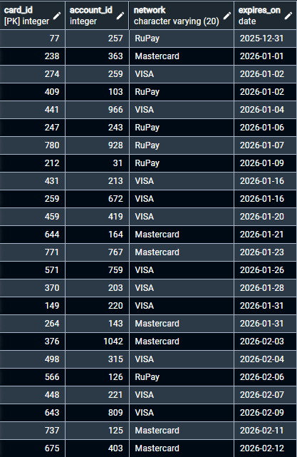
-- 49. Cards expiring in next 60 days
SELECT card_id,account_id,network,expires_on
FROM cards
WHERE expires_on > CURRENT_DATE AND expires_on <= CURRENT_DATE + INTERVAL '60 days'
ORDER BY expires_on;

Slide 32
Customer Balance Summary
01
Total Balance Consolidation Across Accounts
Aggregated balances at the customer level to produce consolidated financial positions, enabling comparison of individual customer value and identification of high-balance and low-balance segments.
02
Average & Median Balance Distribution Insights
Computed descriptive statistics (average, median, range) for customer balances to understand distribution patterns and highlight concentration risks across the customer base.
03
Product-Level Balance Contribution Breakdown
Segmented balances by account type (savings, current, salary, fixed deposit) to measure which product
categories drive total customer value and to assess reliance on specific deposit products.
04
Customer Tiering & Financial Classification
Grouped customers into balance tiers (e.g., <50k, 50k–1L, 1L–5L, >5L) to classify financial health and prioritize customer groups for retention, upsell, and relationship management strategies.

Slide 33


Branch Performance Dashboard
1
Total Deposit Inflow
Rank branches by sum of account balances to identify high-performing locations and allocate resources effectively.
2
Transaction Volume
Count monthly transactions per branch to measure operational capacity and customer engagement levels.
3
Account Growth Rate
Track new account openings by branch to assess local market penetration and sales effectiveness.
4
Channel Mix Distribution
Analyze transaction types (ATM vs branch vs online) to optimize staffing and infrastructure investments.

Slide 34
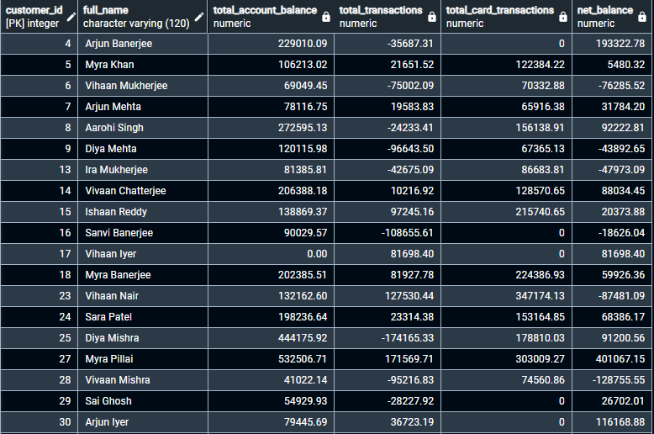
-- 50. Cureent balance left in accounts by customers(who have accounts or cards or both)
WITH
acct AS (
SELECT customer_id, SUM(balance) AS sum_account_balance
FROM accounts
GROUP BY customer_id
),
txns AS (
SELECT a.customer_id, SUM(t.amount) AS sum_txn_amount
FROM transactions t
JOIN accounts a ON t.account_id = a.account_id
GROUP BY a.customer_id
),
card_txns AS (
SELECT a.customer_id, SUM(ct.amount) AS sum_card_txn
FROM cards ca
JOIN accounts a ON ca.account_id = a.account_id
JOIN card_transactions ct ON ca.card_id = ct.card_id
GROUP BY a.customer_id
)
SELECT
c.customer_id,
c.full_name,
COALESCE(ac.sum_account_balance,0) AS total_account_balance,
COALESCE(tx.sum_txn_amount,0) AS total_transactions,
COALESCE(cc.sum_card_txn,0) AS total_card_transactions,
ROUND(
COALESCE(ac.sum_account_balance,0)
+ COALESCE(tx.sum_txn_amount,0)
- COALESCE(cc.sum_card_txn,0)
,2) AS net_balance
FROM customers c
LEFT JOIN acct ac ON c.customer_id = ac.customer_id
LEFT JOIN txns tx ON c.customer_id = tx.customer_id
LEFT JOIN card_txns cc ON c.customer_id = cc.customer_id
-- optional: show only customers who have some accounts/cards/transactions
WHERE COALESCE(ac.sum_account_balance,0) <> 0
OR COALESCE(tx.sum_txn_amount,0) <> 0
OR COALESCE(cc.sum_card_txn,0) <> 0
ORDER BY c.customer_id;

Slide 35

-- 51. Cureent balance left in customers account id(who have accounts or cards or both)
SELECT
c.customer_id,
c.full_name,
a.account_id,
a.balance AS account_balance,
ROUND(
a.balance
+ COALESCE(t.txn_sum,0) -- transactions on this account
- COALESCE(ct.card_txn_sum,0) -- card transactions on cards linked to this account
, 2) AS net_balance
FROM customers c
JOIN accounts a ON c.customer_id = a.customer_id
LEFT JOIN (
SELECT account_id, SUM(amount) AS txn_sum
FROM transactions
GROUP BY account_id
) t ON a.account_id = t.account_id
LEFT JOIN (
SELECT ca.account_id, SUM(ct.amount) AS card_txn_sum
FROM cards ca
JOIN card_transactions ct ON ca.card_id = ct.card_id
GROUP BY ca.account_id
) ct ON a.account_id = ct.account_id
ORDER BY c.customer_id,
c.full_name;

Slide 36

-- 52. TOP 50 richest customers in our bank
WITH
acct AS (
SELECT customer_id, SUM(balance) AS sum_account_balance
FROM accounts
GROUP BY customer_id
),
txns AS (
SELECT a.customer_id, SUM(t.amount) AS sum_txn_amount
FROM transactions t
JOIN accounts a ON t.account_id = a.account_id
GROUP BY a.customer_id
),
card_txns AS (
SELECT a.customer_id, SUM(ct.amount) AS sum_card_txn
FROM cards ca
JOIN accounts a ON ca.account_id = a.account_id
JOIN card_transactions ct ON ca.card_id = ct.card_id
GROUP BY a.customer_id
)
SELECT
c.customer_id,
c.full_name,
COALESCE(ac.sum_account_balance,0) AS total_account_balance,
COALESCE(tx.sum_txn_amount,0) AS total_transactions,
COALESCE(cc.sum_card_txn,0) AS total_card_transactions,
ROUND(
COALESCE(ac.sum_account_balance,0)
+ COALESCE(tx.sum_txn_amount,0)
- COALESCE(cc.sum_card_txn,0)
,2) AS net_balance
FROM customers c
LEFT JOIN acct ac ON c.customer_id = ac.customer_id
LEFT JOIN txns tx ON c.customer_id = tx.customer_id
LEFT JOIN card_txns cc ON c.customer_id = cc.customer_id
WHERE COALESCE(ac.sum_account_balance,0) <> 0
ORDER BY net_balance DESC
LIMIT 50;

Slide 37

-- 53. Accounts that have low balance(Below 10000/-)
SELECT
c.customer_id,
c.full_name,
c.phone,
a.account_id,
a.balance AS account_balance,
ROUND(
a.balance
+ COALESCE(t.txn_sum,0) -- transactions on this account
- COALESCE(ct.card_txn_sum,0) -- card transactions on cards linked to this account
, 2) AS net_balance
FROM customers c
JOIN accounts a ON c.customer_id = a.customer_id
LEFT JOIN (
SELECT account_id, SUM(amount) AS txn_sum
FROM transactions
GROUP BY account_id
) t ON a.account_id = t.account_id
LEFT JOIN (
SELECT ca.account_id, SUM(ct.amount) AS card_txn_sum
FROM cards ca
JOIN card_transactions ct ON ca.card_id = ct.card_id
GROUP BY ca.account_id
) ct ON a.account_id = ct.account_id
WHERE (ROUND(
a.balance
+ COALESCE(t.txn_sum,0)
- COALESCE(ct.card_txn_sum,0)
, 2)) <=10000
ORDER BY net_balance;

Slide 38
Project Summary
This project involves designing and analyzing a relational banking database system that integrates core banking entities such as customers, accounts, transactions, cards, merchants, and loans. The objective is to simulate a real-world retail banking environment and perform structured SQL-based analytics to extract business insights. The schema enables tracking of customer onboarding, product usage, financial flows, loan portfolio exposure, card spend behavior, and operational KPIs through a normalized database structure.
Across 40+ analytical SQL queries, the project demonstrates practical skills in joins, aggregations, window functions, date/time functions, CTEs, views, and data quality checks, tailored for financial analytics. The final output showcases SQL capability for modeling, reporting, and decision support in banking operations.

Slide 39
Impact & Business Value
Improved Customer Visibility (360° Insight):
Consolidated customer profiles across products (accounts, cards, loans) to identify high-value customers and support targeted retention and cross-sell strategies.
Operational Efficiency in Monitoring Financial Activity:
Built transaction-, branch-, and product-level analytical views that streamline reporting of inflows/outflows, allowing faster detection of inactivity, anomalies, and performance deviations.
Better Risk & Portfolio Oversight:
Loan status, tenure analysis, and default rate monitoring provide a foundational structure for understanding credit exposure and early identification of risk clusters.
Revenue Enablement Through Product Analytics:
Card and merchant spend insights, interest and fee tracking, and product penetration metrics help highlight growth opportunities across banking channels and product lines.
Strategic Decision Support:
Period-based KPIs, balance tiering, and customer segmentation enable scenario evaluation and resource prioritization, supporting decisions for marketing, branch performance management, and portfolio optimization.

Slide 40
Business Recommendations
Increase Cross-Selling to High-Balance, Low-Product Customers:
Customer balance tiering shows a segment holding high deposits but with few products (e.g., no cards or loans). Recommend launching targeted product bundling offers (credit cards, investment/FD advisory, personal loans) to increase product penetration and improve revenue per customer.
Strengthen Retention Strategy for Dormant/Low-Activity Accounts:
Dormancy and inactivity analysis reveal customers with no transactions in 90+ days. Recommend re-engagement campaigns (fee waivers, digital channel onboarding, rewards for first transaction) to reduce churn risk and maintain deposit base stability.
Optimize Channel Operations Based on Usage Trends:
Channel mix analytics identify dominant transaction channels (UPI/Online) vs. low-usage channels (branch/ATM). Recommend shifting branch staff focus to advisory roles vs. transactional work and investing more in digital UX and mobile banking features to support demand.
Prioritize Risk Controls for High Default–Risk Loan Categories:
Loan performance analysis highlights categories/regions with higher default ratios. Recommend revising credit underwriting thresholds, introducing early warning scorecards, and strengthening collections/monitoring for high-risk categories.
Merchant Partnerships Based on Category Spend Concentration:
Card spend analytics show high spend in specific categories (fuel, groceries, travel). Recommend forming co-branded partnerships with top merchants, offering reward multipliers and cashback to drive card usage and fee revenue.

